Slide 1
Foothills Utilities
July 23, 2024

Slide 2
Since Foothills purchased Far West Water and Sewer on October 6, 2022, we have invested in much-needed improvements in our infrastructure to better serve our customers. The previous owners deferred investment and maintenance and, as a result, had many compliance issues.

Slide 3
Foothills inherited an ADEQ consent order on multiple issues. After millions of dollars of investment, Foothills Utilities returned to full compliance. Foothills has also completed a CC&N expansion with the ACC and achieved our 100-year water availability approval with ADWR. Foothills strives to ethically improve the water and sewer utility beyond industry standards and compliance and practice good community relations.

Slide 4
Foothills was in triage mode for months but since made great improvement and has more important investments planned to remain in compliance in the future. We have completed Master Planning as a road map for Water and Sewer to prioritize these crucial investments. We have invested over $26 million in crucial improvements to date. These investments create the need for a rate case filed with the ACC.

Slide 5
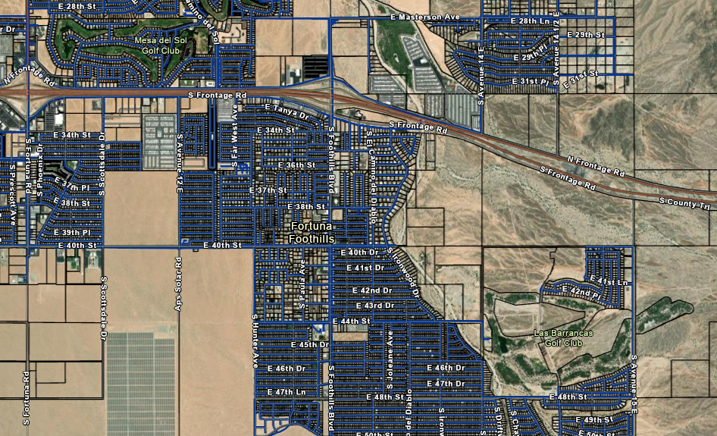
Foothills Water System

Slide 6
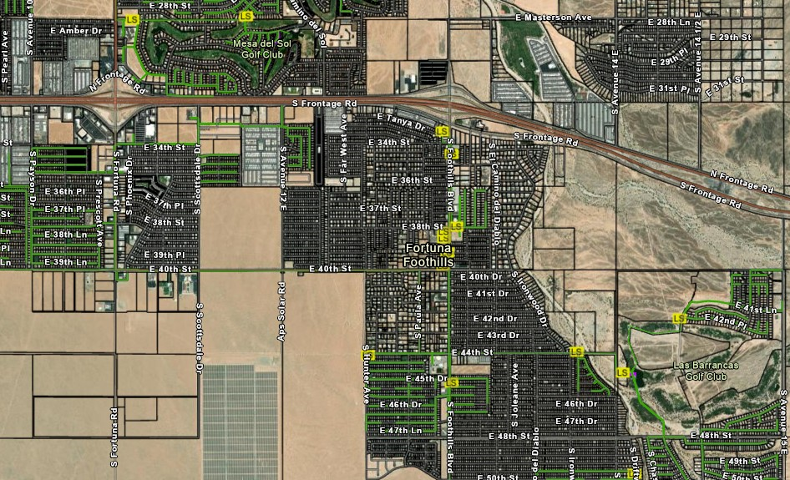
Foothills Sewer System

Slide 7
Planning and Upgrades
*An Engineering Odor Control Plan has been completed and is presently being implemented including Trident Twister Ozone technology, GAC treatment, and Biological filtration that greatly improve odor control.
*A Capacity Management Operation and Maintenance Plan has been completed(CMOM). This allows us to protect our investments in infrastructure.
*Supervisory Control and Data Acquisition (SCADA) upgrades are now completed for all our WW and Water facilities. This technology improves reliability and oversight.
*Crucial Safety training and oversight by our Safety Manager has been implemented. Our proactive Safety culture replaces a very negative safety history under prior management.

Slide 8
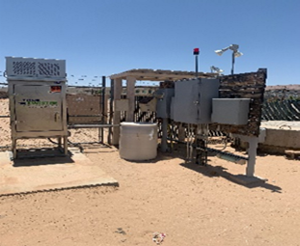
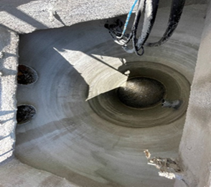
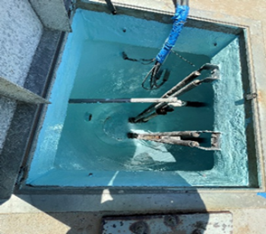
Capital Investments and Improvements Under Foothills Utilities
Wastewater Lift Station # 12
Wetwell walls, cement/coating repair completed. Southwest Environmental from Phoenix, AZ did the work. The odor control system has been replaced with the Titus Twister Ozone Odor control system. This work was done to extend the life of the lift station and reduce odor.

Slide 9
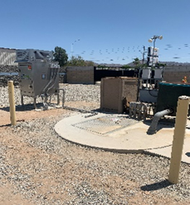
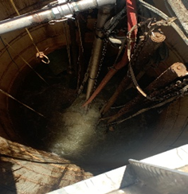
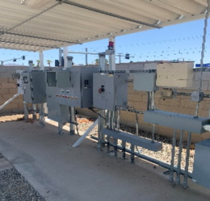
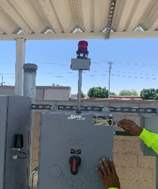
Wastewater Lift Station 40th St
The odor control system has been replaced with the Titus Twister Ozone Odor control system. A new ozone diffuser has been installed at the bottom of the Wet Well. All the alarms are operational, and the floats have been replaced with a new beacon installed at the control panel. This work was done to extend the life of the lift station and reduce odor.

Slide 10

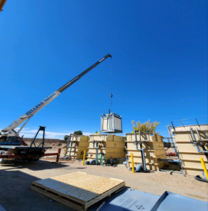
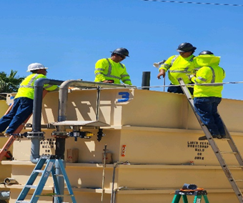
Membrane Bioreactor Wastewater
Upgrades
MBRs (the membrane filters) were added at our Seasons, Section 14, and Del Oro Wastewater Treatment Plants. This work was done to comply with our permitted capacity requirements and improve the treatment process.

Slide 11
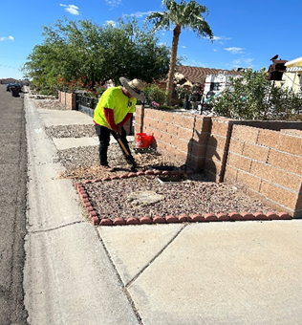
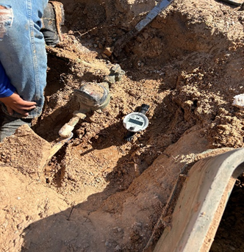
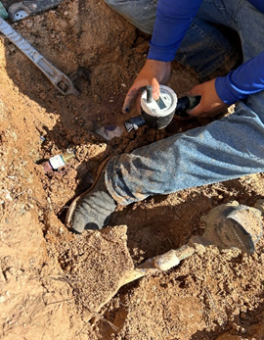
Kamstrup Automated Meter Reading (AMR) Smart Meter Installations
Kamstrup remote-read smart meters are now installed system-wide. Leak detection and reliable usage readings will be delivered by these ultra-sonic technology meters. This full replacement of our meters was overdue as meters dated back decades and for improved customer service.

Slide 12

Foothills Utilities implemented the new UMS billing system in October of 2023. This system is a big improvement over the previous billing system.

Slide 13
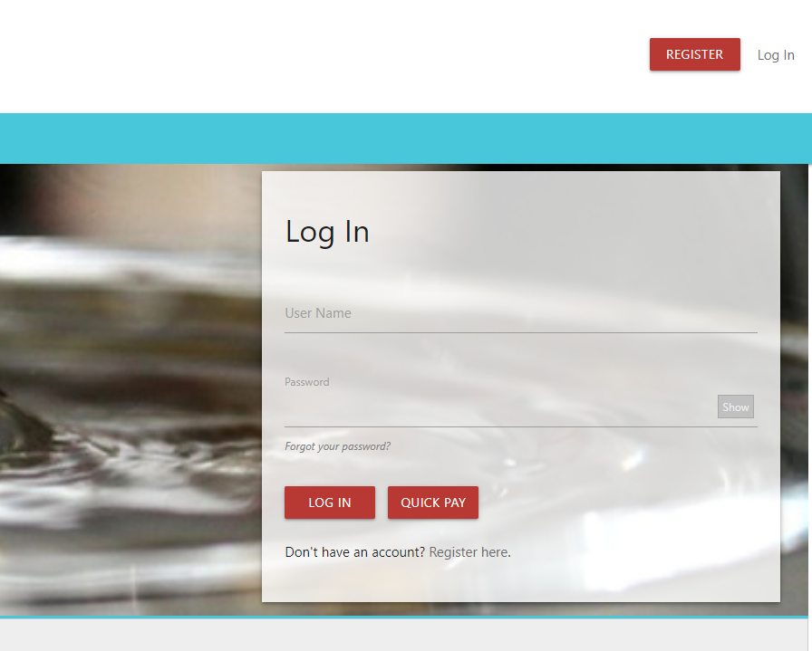
Customer Experience
Customer Contact Update:
Call Back Option- Provides the option to receive a call back instead of waiting on hold.
Automated Voicemail Response- Receive a timely answer to voicemails.
Chat and Email Functionality- Offers alternative channels for support coming soon.
Customer Web Portal
Free 24/7 Online Bill Pay with Credit Card & Electronic Check
View Current and Past Statements
Customer Account Management
View History
Quick Pay Feature for Unregistered Customers

Slide 14
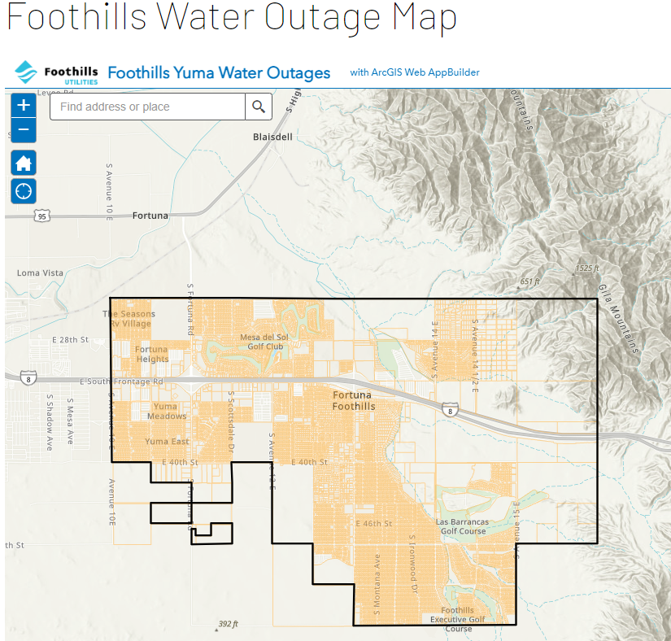
Outage Management
Website:
Provides access to outage map and enables customers to report outages and emergencies.
GIS Outage Map:
Portal displays estimated restoration times and the number of customers affected.
Rave:
Emergency alerts via SMS, email, and phone call.
IVR:
Prompts updated to advise customers we are aware of the affected area.

Slide 15
Rate Case Overview
Ray Jones - Consultant

Slide 16
Topics
Scope
Process
Rate Increase Request
Rate Design Issues

Slide 17
Scope
All Foothills Utilities Customers
  Water & Sewer Customers
  Water Only Customers
  Sewer Only Customers
Residential, Commercial, RV Park

Slide 18
Process - Timeline
Application Filed – 10/31/2023
ACC Issued Sufficiency – 11/30/2023
  Begins a 360 day processing period
Customer Notification – January/February 2024
Staff / RUCO Audit and Testimony – December 2023 - May 2024
Settlement Agreement – July 2024
  Signed July 16, 2024
  Foothills – ACC Staff – RUCO
  Not Binding on Commission

Slide 19
Process - Timeline
Hearing – August 5, 2024
  Public Comment
  Testimony Supporting Settlement
Administrative Law Judge Review
Recommended Order – Sept - Oct 2024
Open Meeting – October 2024
New Rates in Effect – 11/1/2024

Slide 20
Process - Timeline
All Dates Subject to Change
  Delays are not uncommon
Customer Participation
  Company Public Meetings
  Foothillsutilities.com
  ACC – Docket WS-21182A-23-0292
    Call Commission
    File comment at www.azcc.gov
    Attend / Participate Public Comment Sessions – July 24 & 29, Aug. 5

Slide 21
Process - Financial
Capital Investment (Rate Base)
x Cost of Capital (Equity & Debt)
= Return on Investment
+ Expenses
= Revenue Requirement
Allocate Revenue Requirement
to Customer Classes (Rate Design)

Slide 22
Last Water Rate Case
Filed March 12, 1999
Test Year Ending September 30, 1998
Decision No. 61833 (July 20, 1999)
  Interim Rates
Decision No. 62649 (June 13, 2000)
  Rates Effective July 1, 1999
25 Years Since Last Water Increase

Slide 23
Last Sewer Rate Case
Filed July 6, 2012
Test Year Ending December 31, 2011
Decision No. 74097 (Sept. 23, 2013)
  Phase 1 Rates - Effective November 1, 2013
  Phase 2 Rates – Effective May 1, 2014
10 Years Since Last Sewer Increase

Slide 24
Summary Investment
Water Rate Base
  Test Year - Sept. 30, 1998 - $10.9 million
  Test Year – June 30, 2023 - $15.6 million
  43% increase in investment
Sewer Rate Base
  Test Year – Dec. 31, 2011 - $20.0 million
  Test Year – June 30, 2023 - $33.4 million
  67% increase in investment

Slide 25
Summary – Water Filing
Residential Customer Increase
  $2.11 per month – (8.08%)
    Average Usage 6,959 gallons per month
Conservation Oriented Rate Design
  Inverted Tier Rates
Overall Increase – 15.13%

Slide 26
Residential Rate - Water
100% of Residential Customers
  5/8” x 3/4” Meter
Current Rate
  $14.73 Base Charge
  $1.64 per 1,000 gallons
Proposed Rate
  $16.10Base Charge
  $1.64 per 1,000 gallons, 0 – 3,000 gallons
  $1.82 per 1,000 gallons, 3,001 – 10,000 gallons
  $2.34 per 1,000 gallons, over 10,000 gallons

Slide 27
Conservation Oriented Rates- Water
ACC Requirement
  Inverted Tier Rates
Conservation Oriented Rate Shifts Costs to Large Users and Commercial Customers
Shift Cannot Be Avoided
Relationship Between Various Rates
  A zero-sum game
  Lower rates for small users = higher rates for large users

Slide 28
Summary – Sewer Filing
Residential Customer Increase
  $33.99 per month – (60.75%)
  Current Rate - $55.95 per month
  Proposed Rate - $89.94 per month
Commercial Increase – 62.16%
RV Park Increase – 59.19%
Overall Increase – 58.89%

Slide 29
QUESTIONS?

